Slide 1

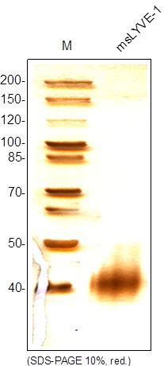
ReliaTech GmbH
Recombinant mouse LYVE-1
(Cat #S01-026)
Fig. 1: SDS-PAGE analysis of recombinant mouse LYVE-1 produced in insect cells. Sample was loaded in 10% SDS-polyacrylamide gel under reducing conditions and stained with Silver stain.
http://www.reliatech.de / orders@reliatech.de

